Slide 1
FIFTH GENERATION OF MOBILE NETWORK
Lecturer: CHEA Socheat
Presentation: I4 Group 3

Slide 2
OUR TEAM
Hun Ravit
e20180328
Hourt Koemly
e20180325
Chheng Afa
e20180106
Hai Mengkuong
e20180236

Slide 3
TABLE OF CONTENTS
01
02
5G use cases, system concept and Frequency
Introduction
03
5G mobile network services requirement trends
04
5G network challenges
05
5G network communication
06
5G and AI

Slide 4
01
5G
Introduction

Slide 5
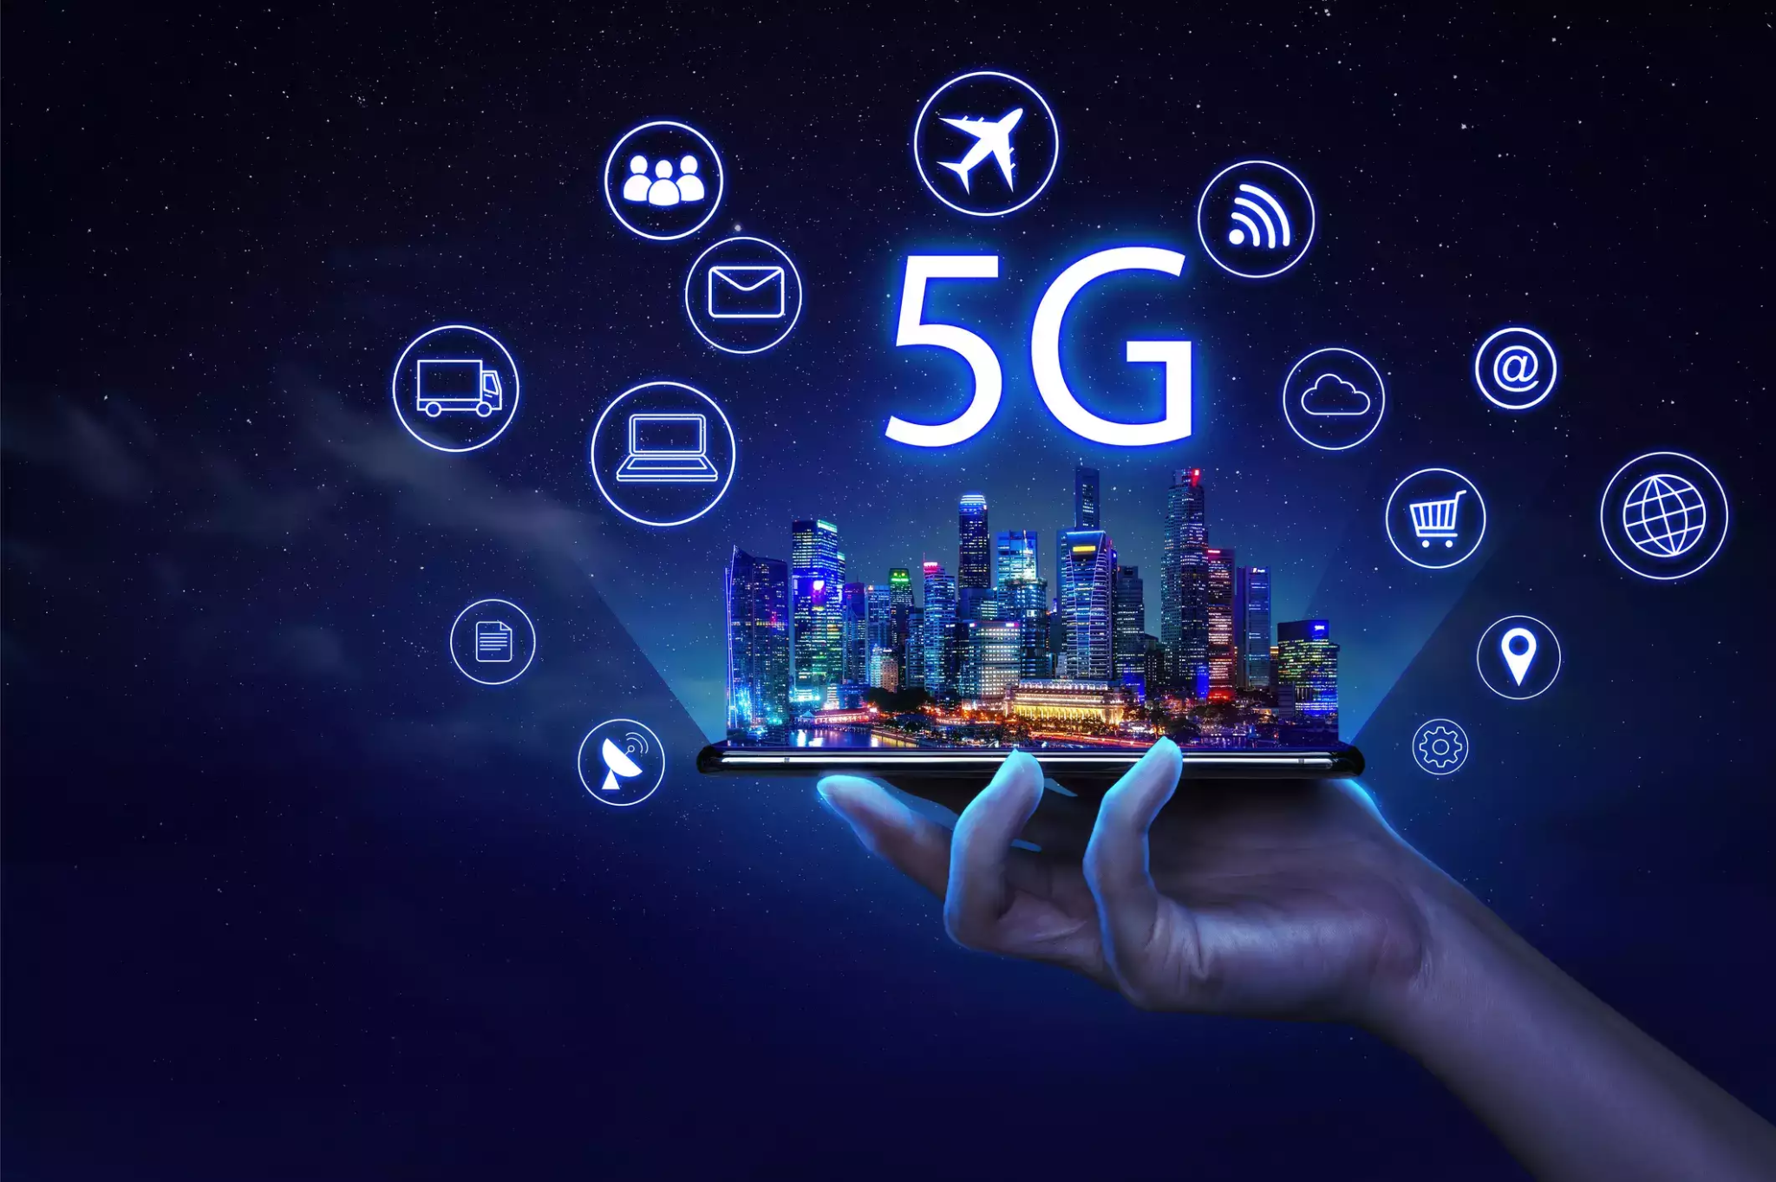
INTRODUCTION
5G is the 5th generation mobile network
No one company or person owns 5G, but there are several companies within the mobile ecosystem that are contributing to bringing 5G to life
It will provide unbelievably fast broadband speeds, but more importantly it will have enough capacity
On April 3,2019, the first 5G-enable smartphone connected to 5G network
5G support 1 million device over 1km area which 10 times more than 4G

Slide 6
02
5G Use Case, System Concept
Frequency band

Slide 7
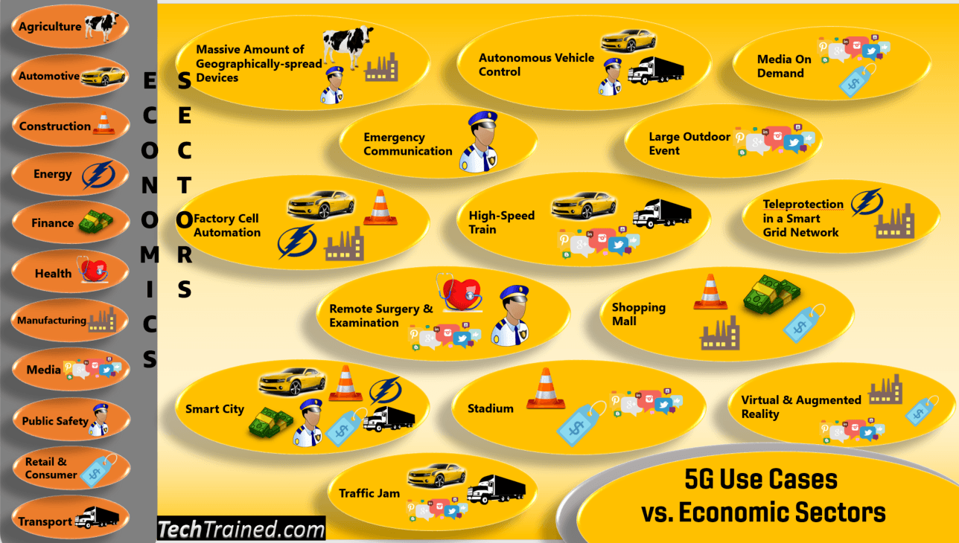
5G Use Case
Industrial IoT
Healthcare
Autonomous Vehicles
Education
Smart City
Stadium
Transportation
Entertainment
Media on demand
Shopping Mall
Streaming high-quality video

Slide 8
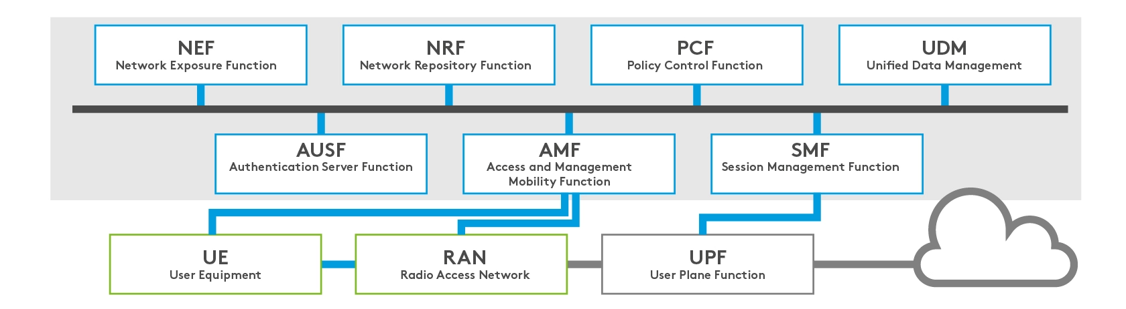
5G System Concept
UE: 5G cellular device
RAN: Coordinate network resources across wireless devices
AMF: The US(user equipment) connection’s single-entry point for the UE connection
UPF: carries the IP data traffic user plane between the UE and external network
AUSF: Enable the AMF to authenticate the UE and access service
SMF: Responsible for managing protocol Data Unit ( PDU ) allocating IP addresses, GRP-U tunnel management and downlink notification management.
NEF: Securely expose the service and capabilities to approved third parties
NRF: Serves as a central repository for network functions
UDM: support advanced authorization and enables operators to easily adapt to customer needs

Slide 9
5G Frequency band
Two different frequency are available for the 5G technology and the different range have been designated FR1(Frequency Range 1) and FR2(Frequency Range 2)
Frequency Range 1
Range from 410 - 7125 MHz
Also known as Sub 8 GHz range
Suitable for continuous coverage, high mobility and reliability
Maximum available bandwidth is 100MHz
Support subcarrier Spacing 15,30 and 60 KHz
Support FDD, TDD, SDL and SUL Duplex Mode
Frequency Range 2
Range from 24250 - 52600 MHz
Also known as Millimeter(mm) Wave Frequencies
Suitable for high capacity and throughput
Maximum available bandwidth is 400MHz
Support subcarrier Spacing 60,120 and 240 KHz
Support only TDD Duplex mode

Slide 10
03
5G Mobile Network services requirement trends

Slide 11
IMT-2020 SERVICES
Extreme Mobile BroadBand (xMBB) or enhanced MBB (eMBB)
Massive Machine-Type Communications(mMTC)
Ultra-reliable Machine-Type Communications(uMTC)
Extremely high data rates,
Low-latency communication in some areas
Reliable broadband access over large coverage areas
Wireless connectivity for up to tens of billions of network-enabled devices worldwide
Scalable connectivity for an increasing number of devices
Wide area coverage and deep indoor penetration are key priorities
Ultra-reliable low-latency
Resilient communication links
Industrial control applications

Slide 12
Technical requirements for 5G services in International Telecommunication Union-Radiocommunication
Service
Category
Peak data rate
User experienced data rate
Spectrum efficiency
Connection density
Network energy efficiency
Area traffic capacity
Mobility
Latency
eMBB
High
High
High
High
Medium
Medium
High
High
mMTC
Low
Low
Low
Low
Low
High
Medium
Low
URLLC
Low
Low
Low
High
High
Low
Low
Low

Slide 13
SUGGESTED CATEGORIZATION
Immersive 5G services
Omnipresent 5G services
Intelligent 5G services
Public 5G services
Autonomous 5G services
VR/AR, massive contents streaming
Internet of things
User-centric computing, crowded area services
disaster monitoring, private security/public safety, emergency services
smart transportation, drones, robots

Slide 14
The similarities between IMT-2020 services & suggested categorization
The immersive and intelligent 5G services, which require high-speed transmission, can be considered as eMBB
Autonomous and public 5G services are related to URLLC
Omnipresent 5G services correspond to mMTC

Slide 15
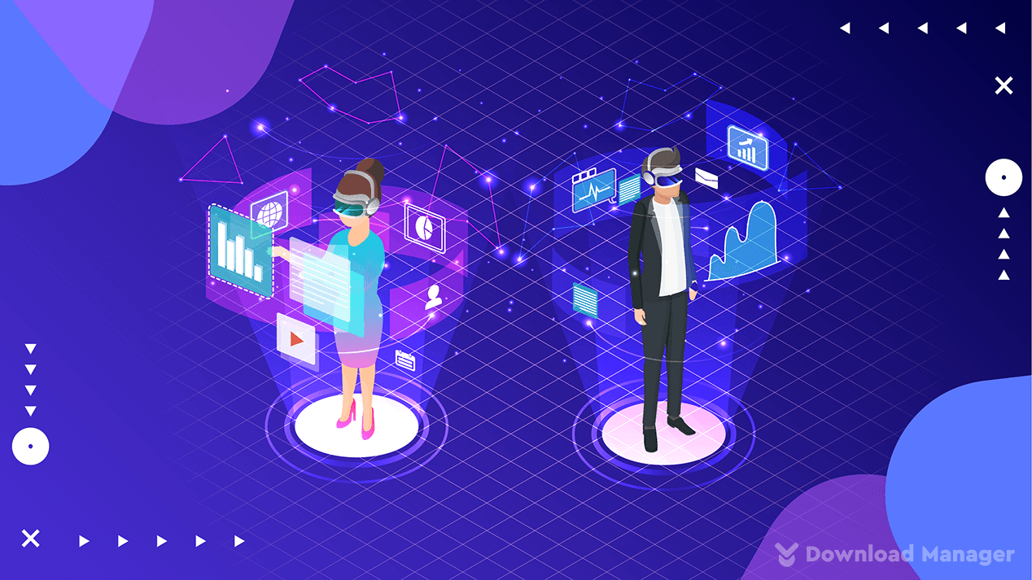

Immersive 5G services
Virtual reality/Augmented reality
Massive contents streaming
5G services will have to handle 4K or 8K resolutions to solve the image quality problem.
5G networks require supporting high bandwidth with low latency
5G support massive content sharing and 3D hologram.
5G is required to support such multidimensional realistic media services
5G support multi-view interactive 3D
5G support personal multimedia broadcasting

Slide 16
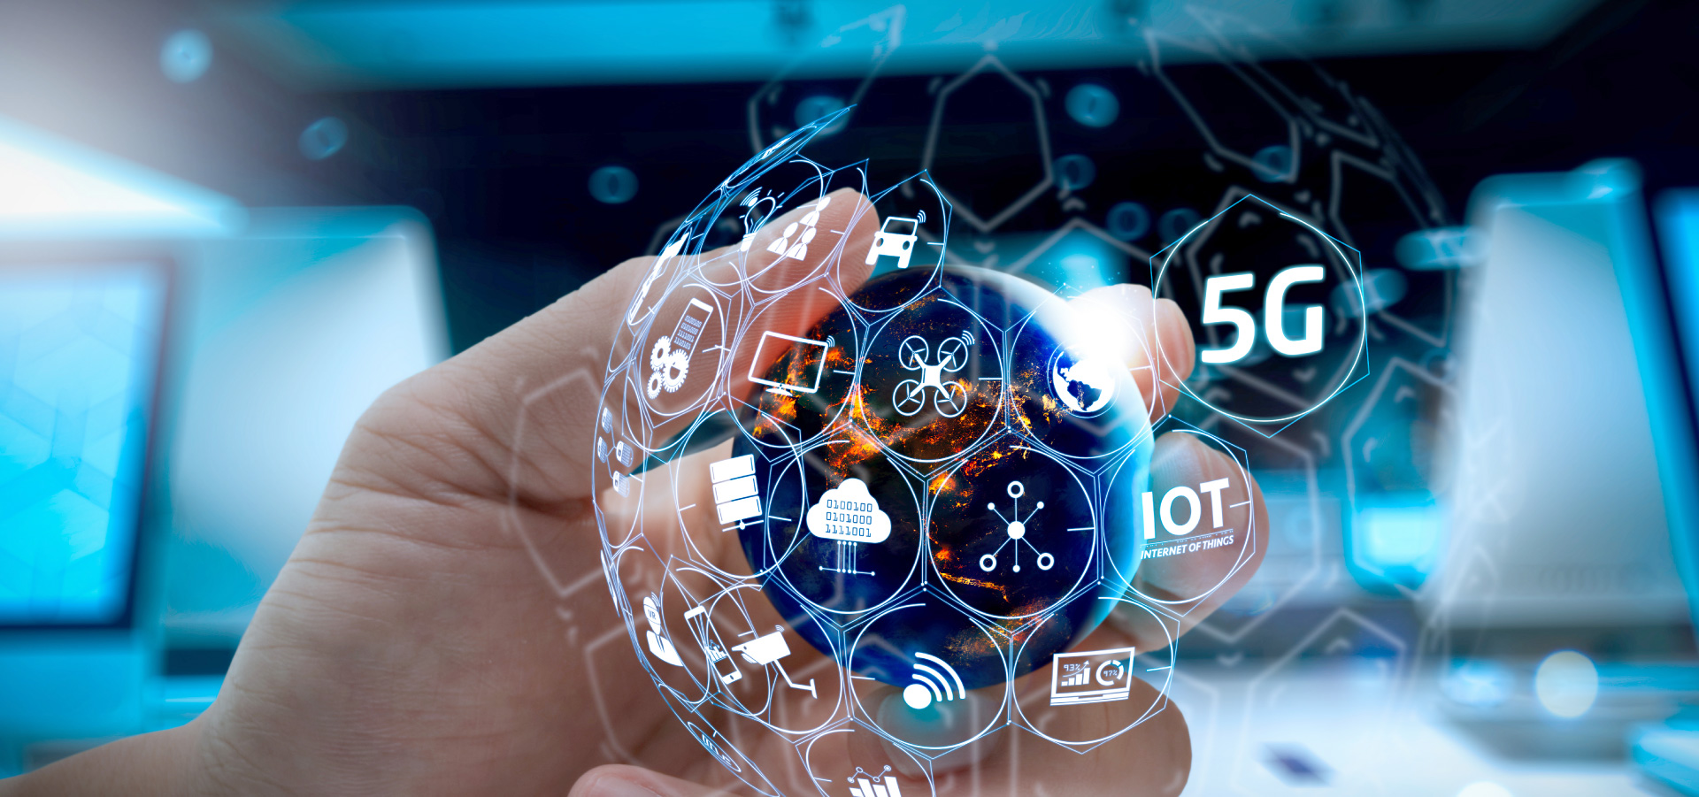

Intelligent 5G services
User-Centric Computing
Crowded Area Services
Increase the data rate and decrease latency.
Additionally, accurate localization of mobile terminals is required to provide these services in a timely manner
5G can provide using many base stations and the available backbone bandwidth effectively without any interruption by adopting the small-cell concept and mobile edge computing.

Slide 17
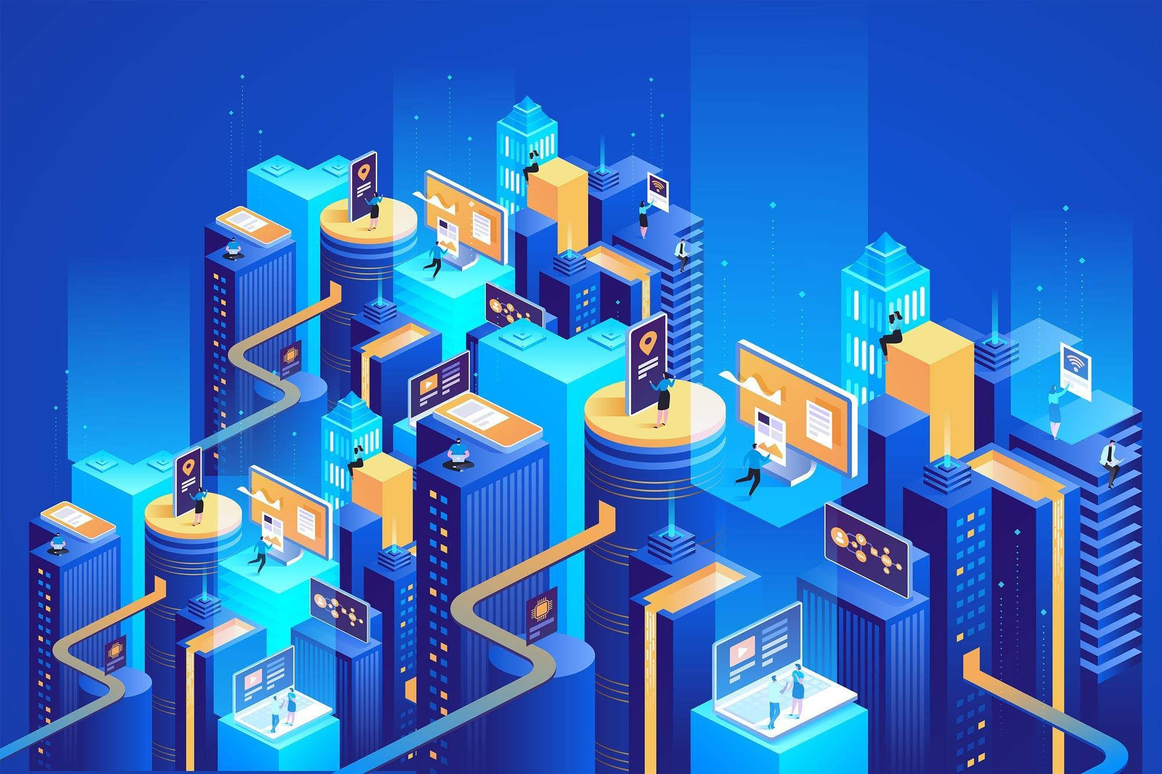
Omnipresent 5G Services
Internet of Things
5G technologies for transmission and networks have to be able to maintain multiple network connections with many devices using limited resources.

Slide 18
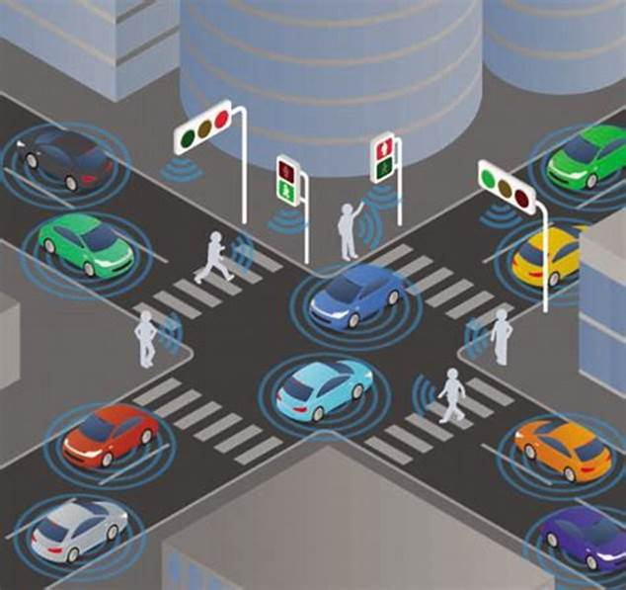

Autonomous 5G services
Smart transportation
Robots
5G base-stations can ﬁgure out the location and speed information of vehicles in real time.
5G combined with artiﬁcial intelligence (AI) algorithms that used in smart transportation
5G will provide networking functions that are necessary for robot evolution.
The information ﬂow between assemblies and control systems with robots is another example of 5G services
5G for robot services provides several limitations associated with the current technologies, such as latency, reliability and high throughput, for such applications of robots.

Slide 19
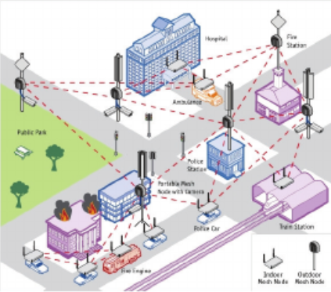
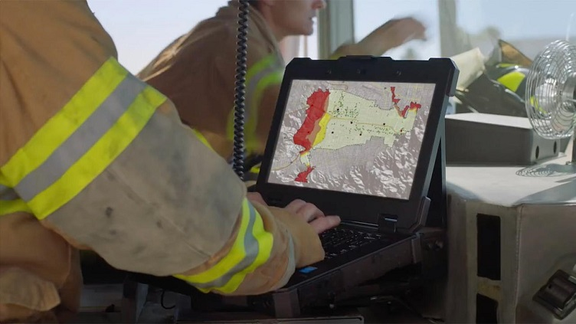
Public 5G Services
Emergency Services
Private Security and Public Safety
The limitations of current technologies for these types of services include reliability and the requirement of low latency.
high-quality videos regarding the emergency area and the medical data on the patients need to be sent with high speed and wider network coverage.
5G will be suitable for such types of emergency services, with its ultra-reliable wireless transmission and latency within 1 ms.
5G can provide advanced security mechanisms and public safety service data according to priority.
Mission critical services requiring very high reliability and global coverage will be supported by the 5G infrastructure.

Slide 20
04
5G Network Challenges

Slide 21
5G challenges
The challenges of 5G are categorized into two headings:
Technological Challenges
Inter-cell interference
Efficient Medium Access control
Traffic Management
Common Challenges
Multiple Service
Infrastructure
Communication Navigation Sensing
Security and Privacy
Legislation of Cyber Law

Slide 22
05
5G Network Communication

Slide 23
1.Massive MIMO Communication
Massive MIMO in 5G network is an advanced antenna technology that enhances spectral efficiency, network capacity, coverage and achievable data rate. Massive MIMO uses a large number of antenna elements within the
transmitter and receiver antenna panels to support multiple users simultaneously.

Slide 24
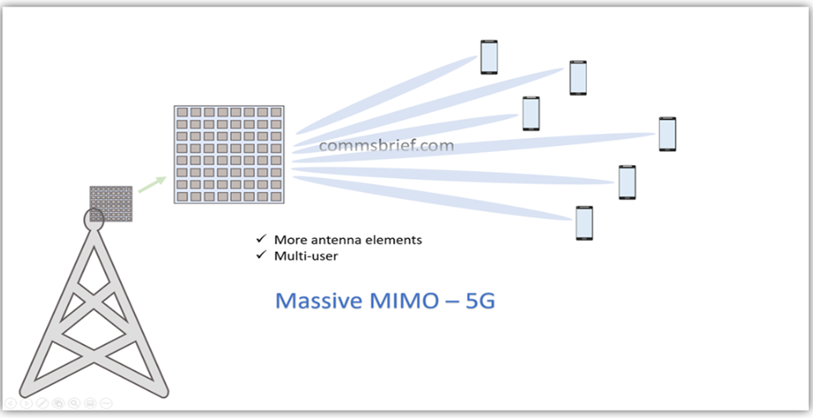
Massive MIMO Communication Work in 5G
The fundamental concept of Massive MIMO in 5G networks is the same as that for standard MIMO in 4G LTE networks. Massive antenna panel of a 5G base station and use spatial multiplexing,diversity and beamforming to increase network capacity,throughput and radio link quality . The addition capacity is used to serve multiple simultaneous users.The transmitter and receiver diversity, spatial multiplexing and beamforming provide the foundation for improving signal reliability and data throughput whilst reducing interference. The additional MIMO enhancement in 5G comes from the sheer volume of antenna elements employed by Massive MIMO and the multi-user application of the antenna elements.

Slide 25
Benefits of Massive MIMO
The benefits of Massive MIMO include spectral efficiency, higher throughput, lower interference and extended range.
Spectral efficiency : Massive MIMO employs spatial multiplexing, which efficiently uses frequency and time resources to improve network capacity and therefor bitrates.
Higher throughput : The use of multiple data streams though spatial multiplexing allows a user divide to get higher overall bit rates.
Lower Interference : The beamforming technique provides targeted transmission of the radio signal, which make the signal more robust in a specific direction.
Extended Range : Massive MIMO has three-dimensional beamforming(3D) , which creates horizontal and vertical beams of the signal so that it can reach people in different range and heights.

Slide 26
2.Millimeter Wave Mobile Communication
Millimeter waves Mobile Communication are also known as extremely high frequency (EHF). It’s radio frequencies that would allow transmission frequencies between 30 GHz and 300 GHz , compared to 5GHz frequencies used by previous mobile devices.
Millimeter Wave Currently Used are Since millimeter wave are overall proven to be saft, many different place currently harness their exceptional capabilities for their own technology.
Scientific Research
Weapons Systems
Security Screening

Slide 27
Advantages and Disadvantage
Millimeter Wave Mobile Communication
Advantages:
Its larger bandwidth is able to provide higher transmission rate, capability of spectrum and is more immune to interference.
Extremely high frequencies allow multiple short-distance usages at the same frequency without interfering each other.
It requires the narrow beam width.For the same size of antenna, when the frequency is increased , the beam width is decreased.
It reduces hardware size. The higher the frequency is, the smaller the antenna size can be used.
Disadvantages:
Higher costs in manufacturing of greater precision hardware due to component with smaller size.
It may result in lower sensitivity in a receiving system due to the lesser energy collected by the smaller size antenna.
At extremely high frequencies , there is significant attenuation.Hence millimeter waves hardly be used for long distance application.

Slide 28
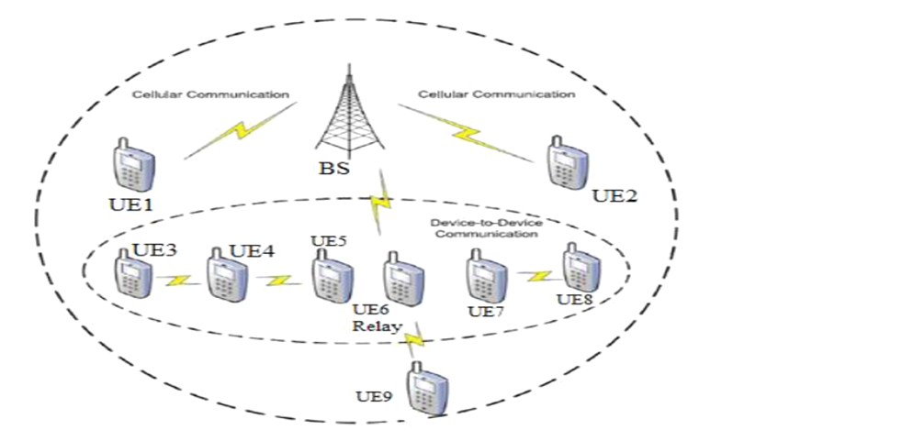
3. M2M and D2D Communication in 5G
i. M2M
What is M2M?
Machine-to-Machine (M2M) refers to the automated exchange of information between devices without manual intervention by human. M2M is used for a wide range of applications, from monitoring and controlling machines to the indexing website by search engines.

Slide 29
How M2M Communication work?
Collect data and transmit it to a network.
Automatically perform actions that are triggered by sequences of events.
Machines optimize their action sequences by ues art of machine learning.
To understand the technology, it’s helpful to know its defining characteristics.
M2M systems consist of the three main components, which are shown below.
Advantages of M2M communication
Faster transmission methods and the ability to schedule data transfers.
Remote control of devices
Reduced need for maintenance
Preventing of outages and subsequent cost saving.
Creates new business opportunities for IT services
Enables companies to improve maintenance and customer services in existing lines of business.

Slide 30
ii. D2D
Advantages of D2D
D2D Application
What is D2D?
Traffic offloading
Public safety
Location-based services
M2M application
V2X communication
D2D (Device-to-Device) refers to the communication between devices, which can be cell phones or vehicles. This technique opens new device-centric communication that often requires no direct communication with the network infrastructure, hence is expected to solve part of the network capacity issue as 5G promises more devices to be connected in faster, more reliable networks.
Traffic offloading
Low power consumption
Low latency
Provide high spectral efficiency
Larger cellular coverage area

Slide 31
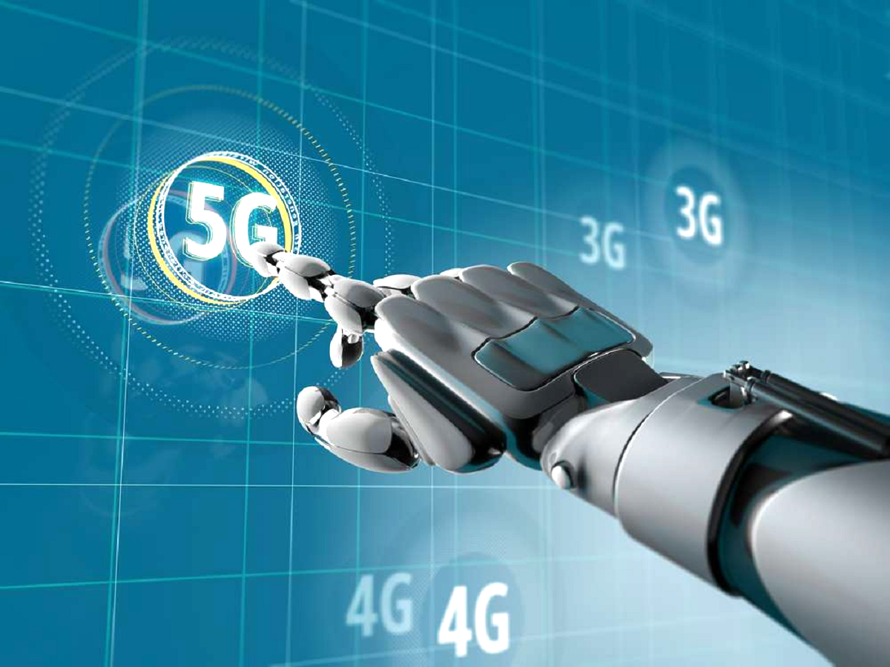
06
5G and AI

Slide 32

i. What is AI?
Artificial Intelligence (AI) is a wide-ranging branch of computer science concerned with building smart machines capable of performing tasks that typically require human intelligence.
There are 4 types of AI:
Reactive Machines
Limited Memory
Theory of Mind
Self-Awareness

Slide 33
ii. What is the role will AI play on 5G?
When Ericsson surveyed decision-markers from 132 worldwide cellular companies, the role will AI play on 5G are:
AI will play on 5G as integration network system.
AI used to improve customer service and enhance customer experience.
AI is the best method for recouping the investments in network planning.
AI efforts on every network performances.
AI adopters who find solutions to these challenges will emerge as the clear frontrunners as 5G networks become connected.

Slide 34
iii. Why is 5G relevant to the field of AI?
5G is up to 20 times faster than 4G, it offers more than just faster speeds.
5G speed will allow developers to create application using a short time.
5G connectivity will allow more access to real-time data from various solutions.
5G systems consume far more power that desired and achieve lower data rates.
Better to develop network communication.
It require far less power for operation.
AI need a connection that has a faster speed for building smart machines capable of performing tasks that typically require human intelligence.
All these opportunities will require the use of AI to make them functional.

Slide 35
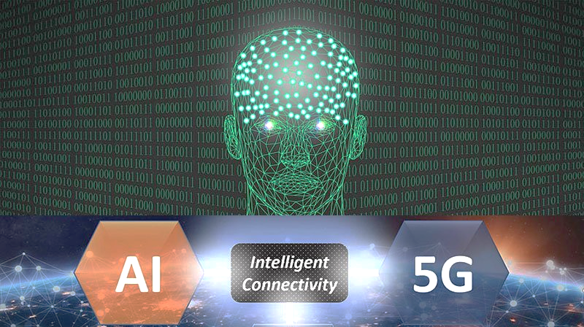
iv. How Does 5G help AI?
AI technology advancements, however, have begun to revolutionize industries and the amount of value all this connectivity can provide to consumers by combining big data, IoT, and AI.
5G accelerates this revolution because the 5G network architecture easily support AI processing. The 5G network architecture will change the future of artificial intelligence (AI). 5G will enhance the speed and integration of other technologies, while AI will allow machines and systems to function with intelligence levels similar to that of human. In a nutshell, 5G speeds up the services on the cloud while AI analyzes and learns from the same data faster.

Slide 36
RESOURCES
5G
5G Use Case
5G Use Case
5G Frequency Band
5G System Concept
5G Challenges
5G Challenges
5G technology and work
Introduction of Massive MIMO
Massive MIMO Communication
Millimeter-Wave Mobile Communications
5G Mobile Network Services Requirement Trends
5G Mobile Network Services Requirement Trends
Introduction Massive MIMO Communication
M2M and D2D Communication
D2D
5G And AI

Slide 37

THANK YOU
FOR YOUR ATTENTION

